Slide 1
AGENTIC RAG CHATBOT FOR MULTI-FORMAT DOCUMENT QA USING MODEL CONTEXT PROTOCOL
A multi-agent intelligent chatbot that answers questions from uploaded PDFs, DOCX, PPTX, CSV, and TXT files using Docling for parsing, FAISS for semantic search, and LLMs for response generation. Powered by Model Context Protocol (MCP) for agent communication and built with a user-friendly Streamlit interface.
Presented By
Ravi Teja Vavilapalli
ravitejavavilapalli21@gmail.com

Slide 2
AGENT-BASED ARCHITECTURE WITH MCP INTEGRATION
Overview:
The chatbot system is designed using a modular agent-based architecture where each agent performs a specific role. These agents communicate using Model Context Protocol (MCP) — a structured message format enabling seamless coordination.
Key Components:
IngestionAgent:
Parses and structures content from documents (PDF, DOCX, PPTX, etc.) using Docling.
RetrievalAgent:
Uses SentenceTransformers to embed chunks and FAISS to retrieve the relevant ones.
LLMResponseAgent:
Takes the question and context to generate an answer using an LLM like LLaMA.
MCP Host/Client:
Orchestrates the message flow between agents using MCP messages (sender, receiver, type, payload, trace_id) to maintain traceable communication.
Notes:
We often deal with long and complex documents — research papers, contracts, reports — and reading through them is not just time-consuming, but also mentally draining.”
“And when we're tired or rushing, it's easy to make mistakes — miss key points, misunderstand details, or draw inaccurate conclusions.”
“In many cases — like legal or academic work — even a small oversight can lead to big consequences. So, we need a system that gives reliable, accurate answers directly from the source material.”
“That’s where my solution comes in — a personalized Document QnA system.”
“Unlike traditional tools that only support one format, this system can handle a variety of document types like PDFs, Word files, Excel sheets, and even PowerPoint slides.”
“This approach drastically cuts down the time and energy spent searching for information.”
“In short — we’re letting AI do the heavy lifting, so users can focus on decision-making rather than document scanning.”

Slide 3
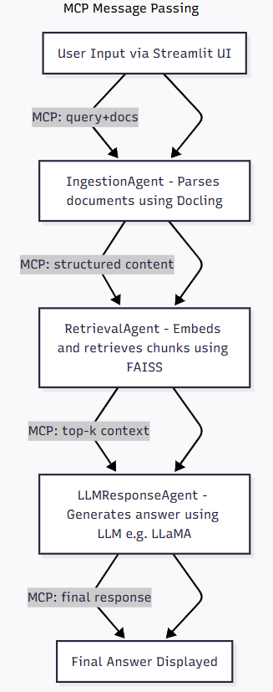
SYSTEM ARCHITECTURE: AGENTIC RAG VIA MCP PROTOCOL
This diagram illustrates the end-to-end flow of user input through RAG using MCP.
1. User Input via Streamlit UI
Users upload documents and provide their query through Streamlit.
2. MCP: Query+Docs
The query and documents are passed through the MCP pipeline.
3. IngestionAgent
Documents are parsed into structured content using docling..
4. MCP: structured content
Parsed chunks are passed to the next agent for retrieval.
5. RetrievalAgent
Retrieves relevant content using FAISS after embedding the chunks.
6. MCP: top-k context and LLMResponseAgent
Retrieved context is forwarded to the LLM which generates the response.
7. MCP: Final response
The final answer is passed back through MCP and displayed in the UI.
Notes:
We often deal with long and complex documents — research papers, contracts, reports — and reading through them is not just time-consuming, but also mentally draining.”
“And when we're tired or rushing, it's easy to make mistakes — miss key points, misunderstand details, or draw inaccurate conclusions.”
“In many cases — like legal or academic work — even a small oversight can lead to big consequences. So, we need a system that gives reliable, accurate answers directly from the source material.”
“That’s where my solution comes in — a personalized Document QnA system.”
“Unlike traditional tools that only support one format, this system can handle a variety of document types like PDFs, Word files, Excel sheets, and even PowerPoint slides.”
“This approach drastically cuts down the time and energy spent searching for information.”
“In short — we’re letting AI do the heavy lifting, so users can focus on decision-making rather than document scanning.”

Slide 4
TECH STACK USED
Frontend:
Streamlit - For building the interactive UI and capturing user inputs.
MCP Protocol:
Model Context Protocol (MCP) – Manages message passing between agents.
Document Processing:
Docling – For parsing and structuring input documents.
Retrieval:
FAISS – Fast similarity search for retrieving top-k relevant document chunks.
Sentence Transformers – For embedding chunks (e.g., all-MiniLM-L6-v2).
LLM Inference:
LLaMA (Groq API) – Used for fast, low-latency inference via Groq’s LPU backend.
Backend Logic:
Python – Core language for all components and orchestration.
Notes:
We often deal with long and complex documents — research papers, contracts, reports — and reading through them is not just time-consuming, but also mentally draining.”
“And when we're tired or rushing, it's easy to make mistakes — miss key points, misunderstand details, or draw inaccurate conclusions.”
“In many cases — like legal or academic work — even a small oversight can lead to big consequences. So, we need a system that gives reliable, accurate answers directly from the source material.”
“That’s where my solution comes in — a personalized Document QnA system.”
“Unlike traditional tools that only support one format, this system can handle a variety of document types like PDFs, Word files, Excel sheets, and even PowerPoint slides.”
“This approach drastically cuts down the time and energy spent searching for information.”
“In short — we’re letting AI do the heavy lifting, so users can focus on decision-making rather than document scanning.”

Slide 5
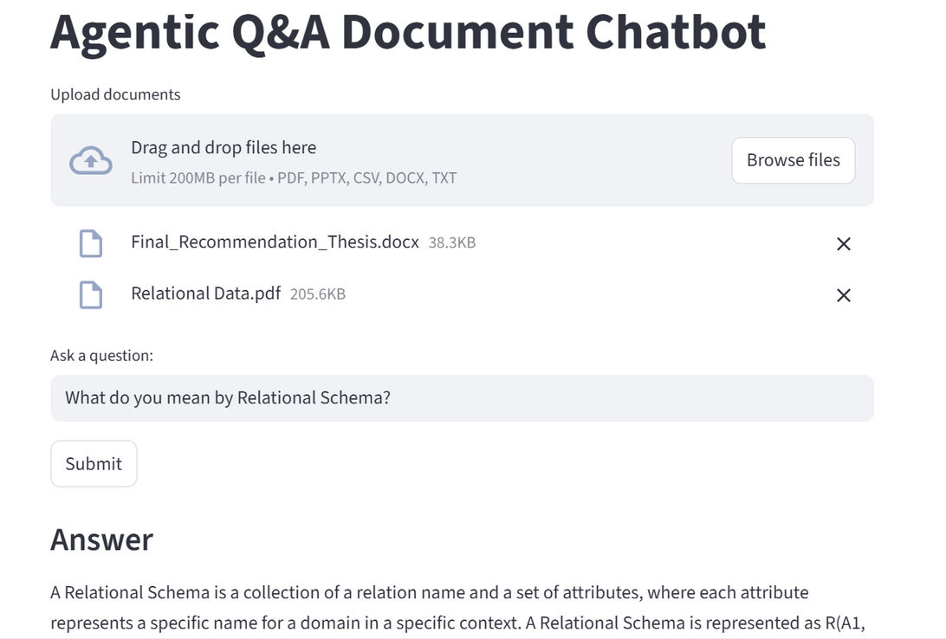
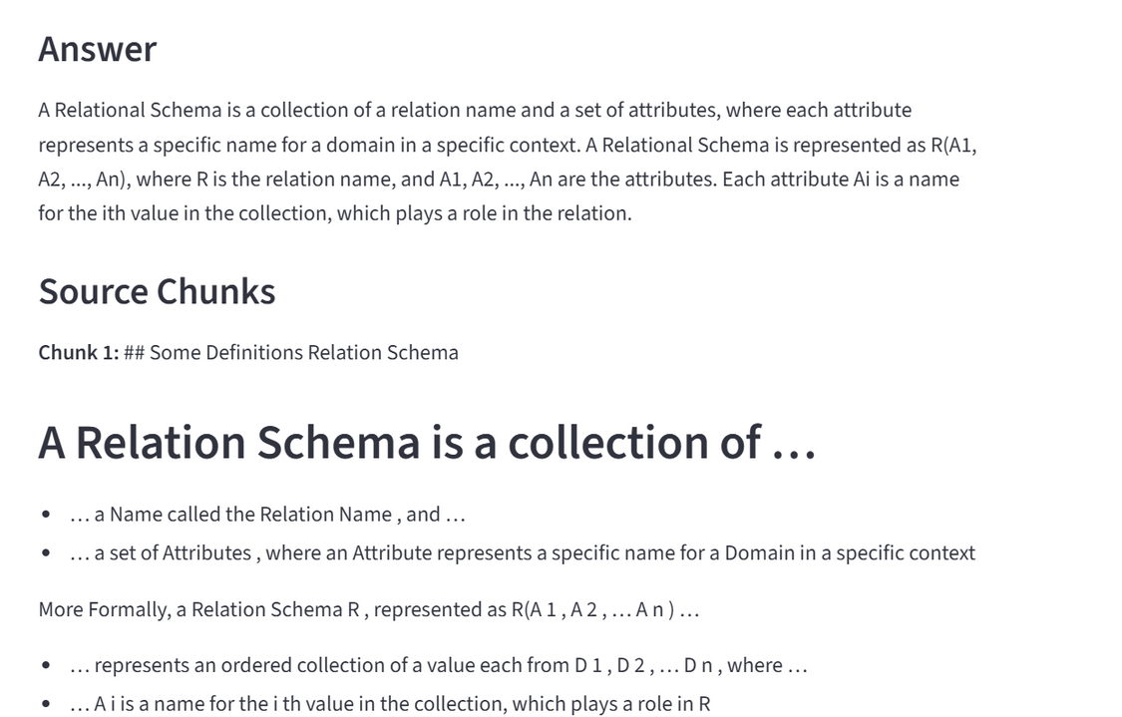
UI SCREENSHOTS OF WORKING APP
Notes:
We often deal with long and complex documents — research papers, contracts, reports — and reading through them is not just time-consuming, but also mentally draining.”
“And when we're tired or rushing, it's easy to make mistakes — miss key points, misunderstand details, or draw inaccurate conclusions.”
“In many cases — like legal or academic work — even a small oversight can lead to big consequences. So, we need a system that gives reliable, accurate answers directly from the source material.”
“That’s where my solution comes in — a personalized Document QnA system.”
“Unlike traditional tools that only support one format, this system can handle a variety of document types like PDFs, Word files, Excel sheets, and even PowerPoint slides.”
“This approach drastically cuts down the time and energy spent searching for information.”
“In short — we’re letting AI do the heavy lifting, so users can focus on decision-making rather than document scanning.”

Slide 6
CHALLENGES FACED WHILE DOING THE PROJECT & IMPROVEMENTS
Challenges Faced:
Parsing complex multi-format documents (PDFs, DOCX, PPTX, CSV) using docling.
Ensuring smooth integration and response generation using Groq API.
Designing a reliable and traceable message flow between agents via MCP.
Managing multiple Python dependencies and library compatibility (FAISS, SentenceTransformers, Streamlit etc.).
Future Improvements:
Fine-tuned LLM integration for domain-specific document understanding.
Add vision-based document understanding to extract data from charts/images.
Enable multi-turn conversations for better context retention.
Implement persistent document indexing using Qdrant or Chroma for long-term memory.
Notes:
We often deal with long and complex documents — research papers, contracts, reports — and reading through them is not just time-consuming, but also mentally draining.”
“And when we're tired or rushing, it's easy to make mistakes — miss key points, misunderstand details, or draw inaccurate conclusions.”
“In many cases — like legal or academic work — even a small oversight can lead to big consequences. So, we need a system that gives reliable, accurate answers directly from the source material.”
“That’s where my solution comes in — a personalized Document QnA system.”
“Unlike traditional tools that only support one format, this system can handle a variety of document types like PDFs, Word files, Excel sheets, and even PowerPoint slides.”
“This approach drastically cuts down the time and energy spent searching for information.”
“In short — we’re letting AI do the heavy lifting, so users can focus on decision-making rather than document scanning.”

